Slide 1
Air Quality UPDATE Maricopa county environmental compliance assistance for business and industry
Mike Sundblom
Director
Pinal County Air Quality Control
October 29, 2019

Slide 2
Pinal County Current Events
PM-10 nonattainment
PM2.5 nonattainment
2015 Ozone NAAQS
2008 Ozone NAAQS
Dust Control Project

Slide 4
Pinal PM10 Status
PM10 nonattainment
NAA Designation - July, 2012
SIP Submitted January 2016
ADEQ was the lead agency; MAG will lead all SIP development in the future
EPA has not approve or disapprove the SIP
PCAQCD Fugitive dust rule and some AGBMP rules approved by EPA
EPA has not acted to change the moderate NAA designation

Slide 5
SIP Control Measures
Agricultural Operations
Open Field Ag, Feed operations, Dairy operations, Irrigation Districts (AgBMP’s – ADEQ)
EPA Proposed SIP Approval 1/2017 (partial list)
Construction Activity
Effective locally 1/1/2016
EPA Proposed SIP Approval 1/2017
Fugitive Dust
Effective locally 1/1/2016
EPA Proposed SIP Approval 1/2017

Slide 6
Pinal PM2.5 Status
PM2.5 nonattainment
NAA Designation – 2011; 2014 Moderate area classification.
EPA required to make attainment determination for the 2015-2017 period by July 2018.
Notice of intent to sue…
Attainment determination October 3, 2019. effective November 3, 2019.

Slide 7
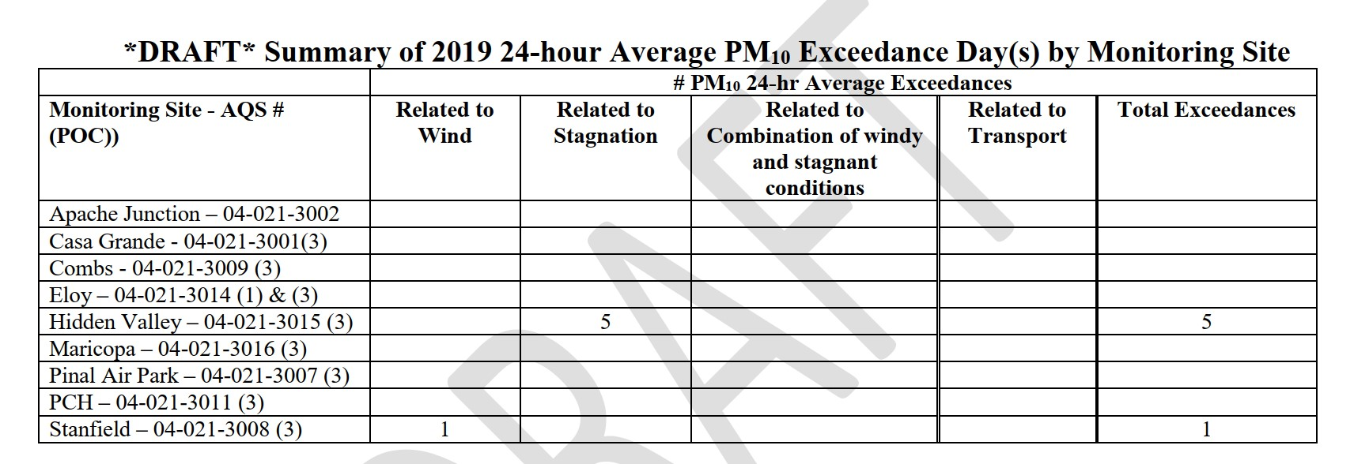
2019 PM10 PM2.5 Summary

Slide 8
2015 Ozone NAAQS
Finalized October 1 2015
70ppb - 3yr avg of 4th highest daily 8 hour conc.
ADEQ proposed NAA Boundary October 2016
EPA took Action March 2018.
NAA Includes a portion of Pinal County
3 Year Average of the 4th High 2017-2019
Site | Concentration PPM
Apache Junction | 0.073
Casa Grande | 0.067
Pinal Air Park | 0.069
Queen Valley
Note: MAG is working on Exceptional events that occurred in 2019 that may change some of the averages above.

Slide 9
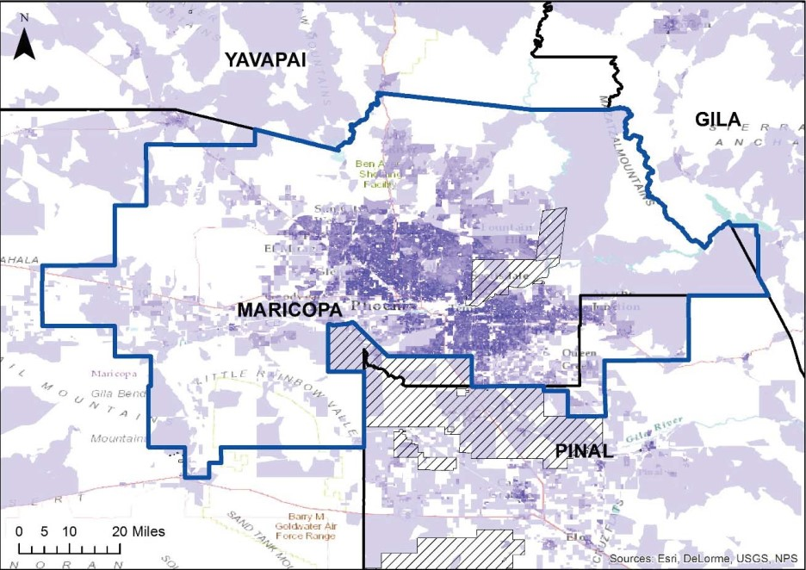

Slide 10
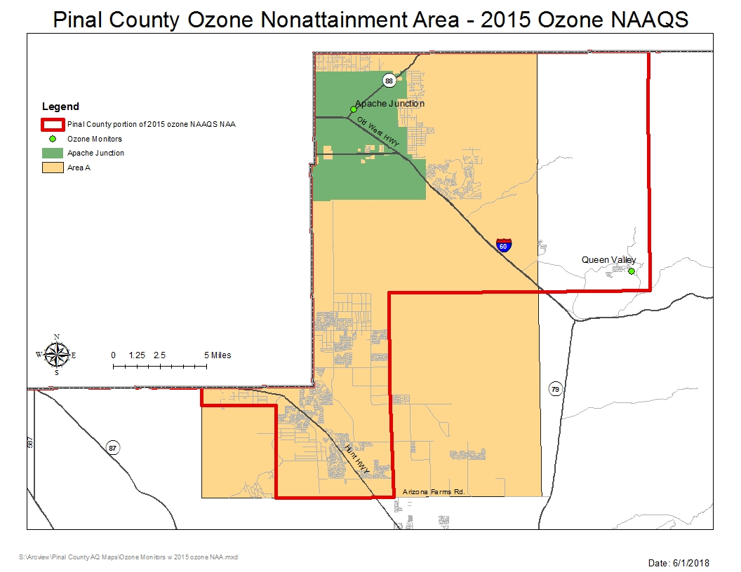

Slide 11
SIP Requirements

Slide 12
2008 Ozone NAAQS
Small area of Pinal Included in Phoenix NAA (Apache Junction)
On June 13, EPA proposed a determination of attainment for the area.
On October 3 2019, EPA proposed to approve the 2017 MAG plan. (disapproval for the contingency measure approach)
Pinal working on RACT level rules for the area - duel distribution and metal coatings

Slide 13
I-10 Picacho (MP214)
Historically a hot spot for dust related accidents
I-10 Workgroup formed in 2016 to study (PCAQCD, ADEQ, ADOT, NRCS, State Land, U of A, public participants)
Soil survey NRSC/PCAQCD
Resulted in 2 step approach:
Short Term Solution (stabilization)
Long Term Solution (contouring, vegetation, etc.)

Slide 15
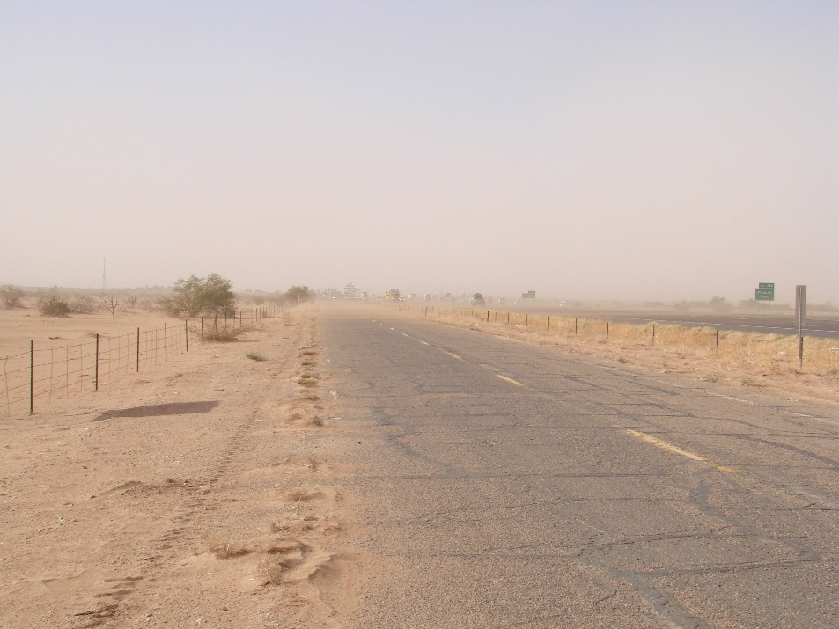
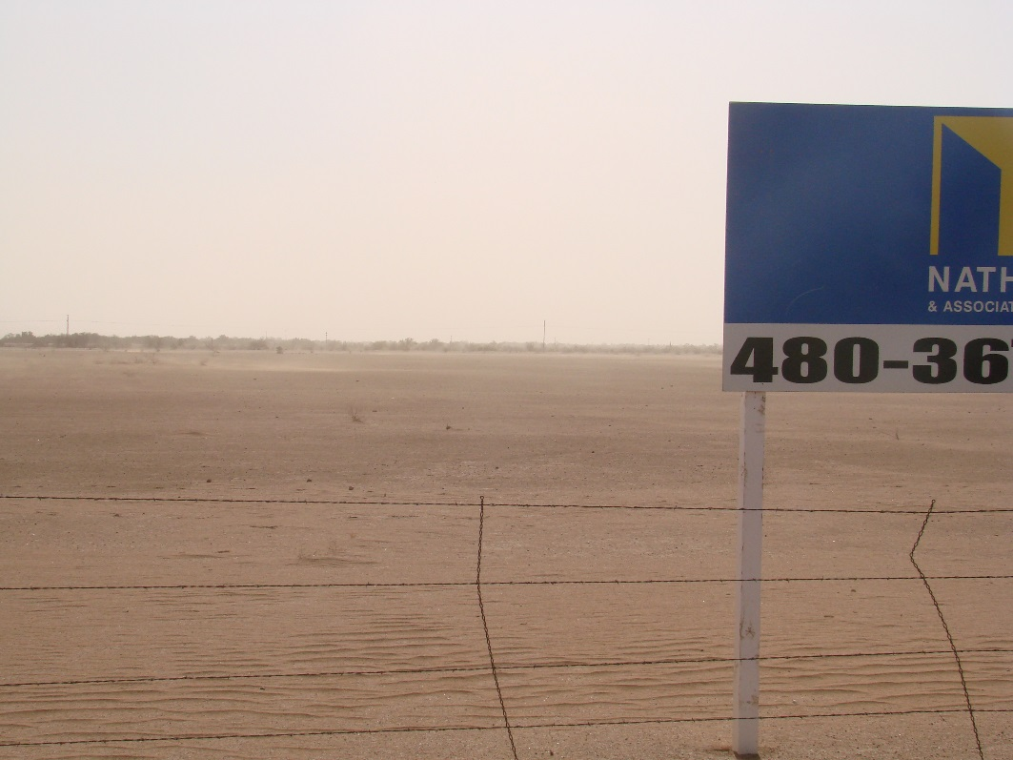
MP214 Pretreatment

Slide 16
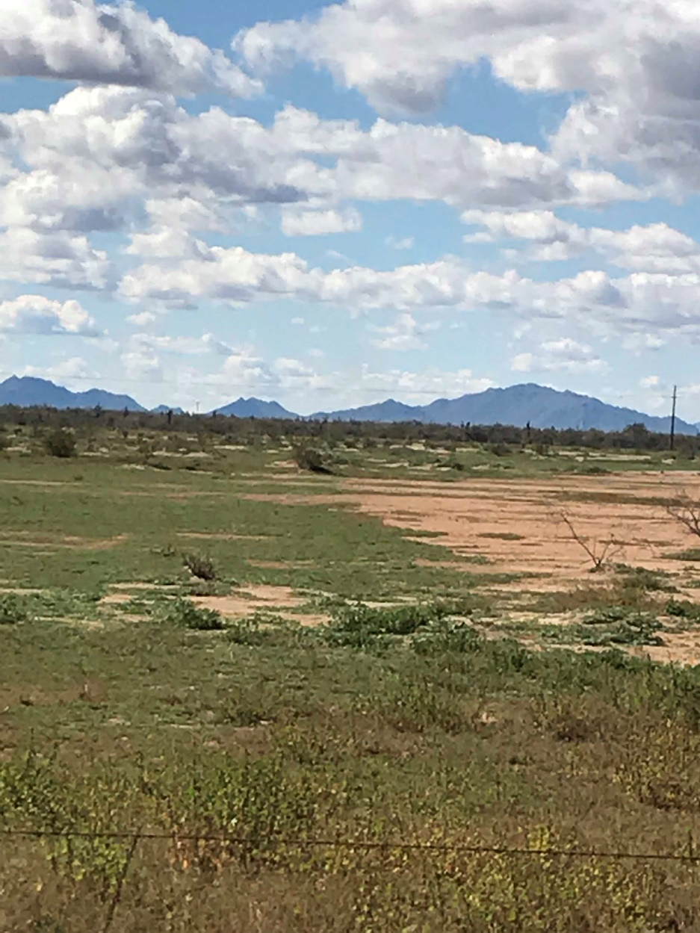
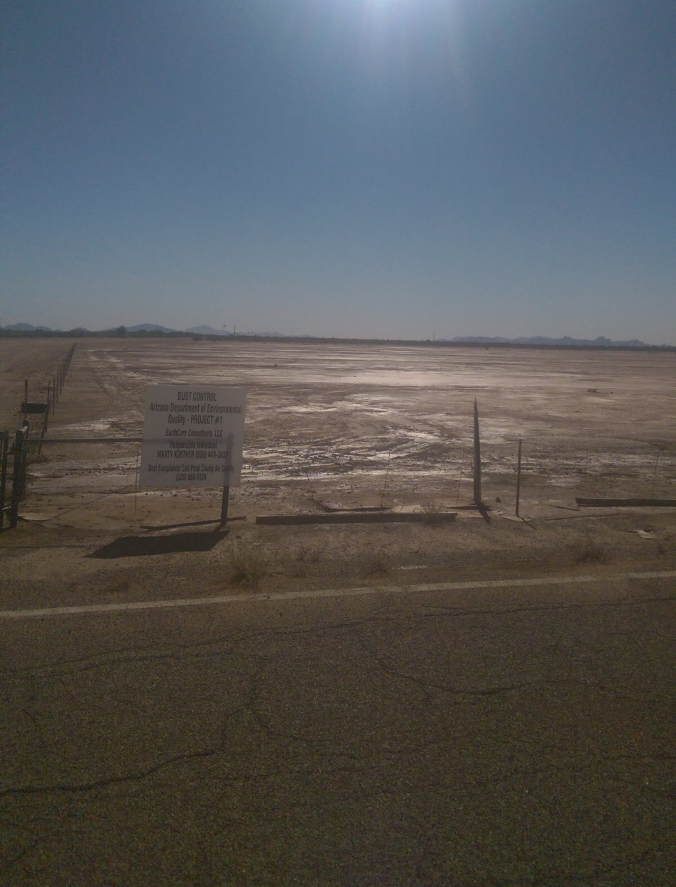
Post Treatment
September 2017
February 2019

Slide 17
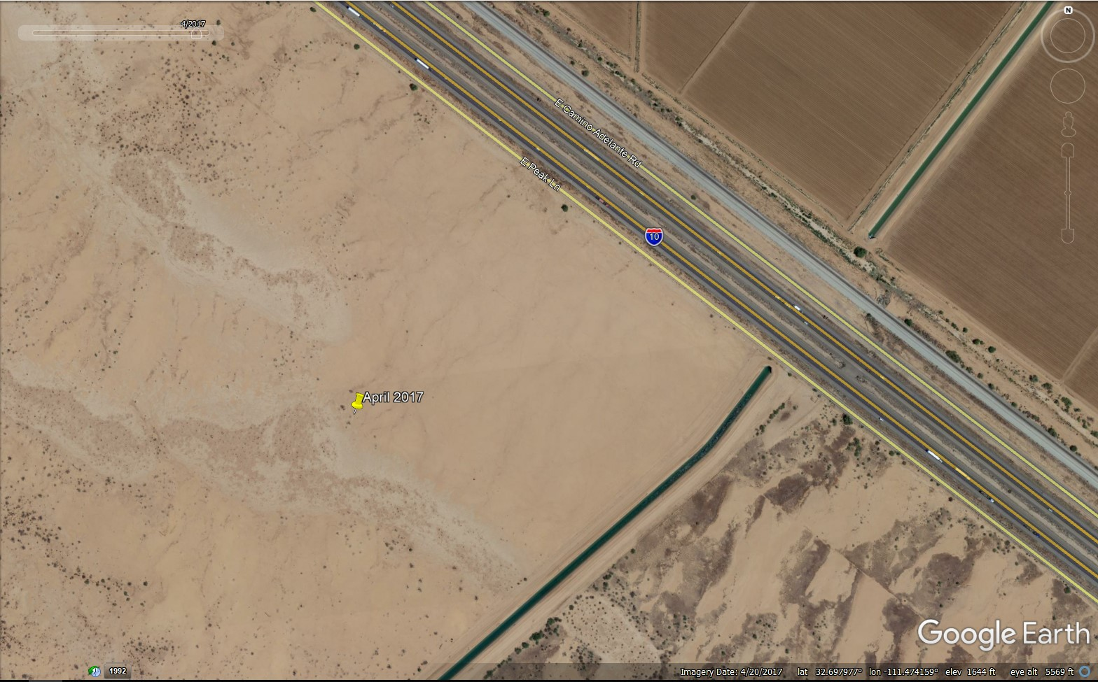
Another View

Slide 18
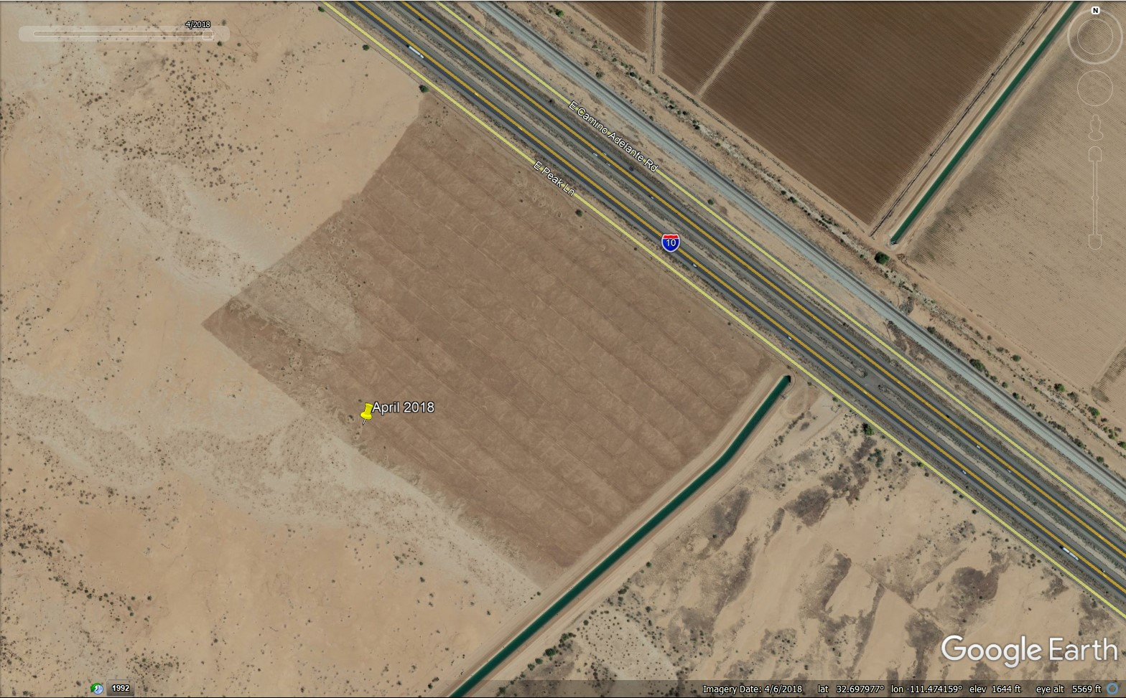
Another View

Slide 19
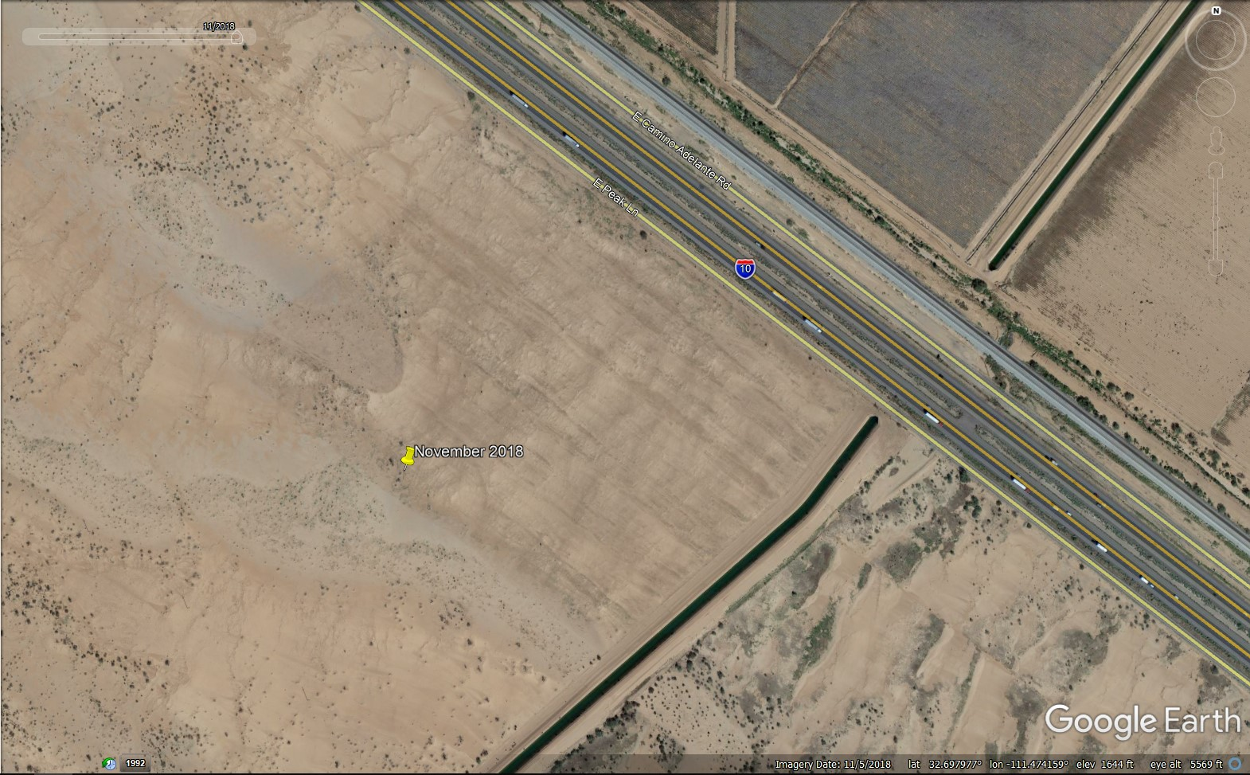
Another View

Slide 20
Recent Work
ADEQ recent fudnded:
U of A research project to evaluate stabilization methods on 3 acres near Picacho Peak
Approximately 100 acres on two different parcels along 1=10

Slide 21
Contact Information
Mike Sundblom
Michael.Sundblom@pinalcountyaz.gov
(520)866-6915

